Slide 1
Creating Effective
Marketing Materials

Slide 2

Is there a right and wrong way?

Slide 3
What’s in it for them???
Demonstrate what you HAVE to offer the employer NOT what YOU want from the employer
Why should I hire you?

Slide 4
A Good Resume…
Is a glorified application.
This type of resume explains to the hiring manager the following information :
education
dates of employment
companies
titles held
job functions
It is good because the hiring manager can get a clear summation of your past experience and education.

Slide 5
A Great Resume…
Is a marketing brochure.
the scope and depth of your experience
describes the expertise you have developed throughout your career that relates to your future employer's needs
A great resume communicates a compelling reason for the prospective employer to need and want your services.

Slide 6
Great resumes
extract the relevant accomplishments
from your past experiences
and highlight them.

Slide 7
It’s not what you know it’s
what you have done
with what you know!!!
Demonstrate where you have applied your knowledge and skills

Slide 8
SELL IT…Don’t Tell it!
TELL IT - Simply states facts
SELL IT – promotes, advertises, draws attention to it, adds impact and value
Don’t be generic – what makes you stand out from the rest
Don’t focus on what you want
Demonstrate skills you have related to the job
A smart resume focuses on relevant skills and qualifications!

Slide 9
CHRONOLOGICAL
Organized according to time in reverse chronological order
Most recent education/experience first
Focuses on dates and job experiences
Most widely used type of resume
Most suitable for students and recent grads
Notes:
Ask students to look at example resume on page 38

Slide 10
TARGETED RESUME
Relate everything to the position applying for
Relevant program skills
Use industry key words
Demonstrate relevant transferable skills
May need to be tweaked for every position you apply for.

Slide 11
GUIDELINES
Blend of good content and attractive format
Easy to follow & maintain consistency
Attract immediate attention (10 – 15 seconds)
1 – 2 pages in length
DO NOT use complete sentences & lengthy paragraphs
Notes:
Give example of sentence fragment:
Trained new employees in all aspects of office duties

Slide 12
DO USE sentence fragments to express complete thoughts (bullets; point form, no periods)
Use appropriate past and present tense
Never use the word “I” in your resume
Be accurate (do not estimate or guess on details)
Proofread meticulously (Spelling; Grammar; Typos)
One mistake could cost you the job

Slide 13
Jane Doe
1400 London Road, Sarnia, ON N7S 6K4
519 542 7771
jdoe@hotmail.com
Jonathan B. Doe
1400 London Road, Sarnia, ON N7S 6K4 519 542-7771 jdoe@hotmail.com
Jane Doe 519 542-7771
1400 London Road, Sarnia, ON N7S 6K4 jdoe@hotmail.com

Slide 14
EDUCATION
Reverse Chronological Order
(Most recent first)
Program name Bold
Make sure you have the proper name of your program!!!
SCHOOL NAME, City, Province
Dates

Slide 15
EDUCATION:
Internet Programming and Database Management 2011 – present
LAMBTON COLLEGE, Sarnia, ON
G.P.A. – 3.7/4.0, Dean’s Honour List
Ontario Secondary School Diploma 2008
NORTHERN COLLEGIATE, Sarnia, ON

Slide 16
Certifications
Computer hardware and software configuration (CompTIA A+) Apr 2013
Project Management (CompTIA IT Project+) Apr 2013
Microsoft Certified Professional, (MCITP) Apr 2013
MCITP-Server Administrator
Windows Server 2008 Active Directory Mar 2013
Windows Server 2008, Server Administrator Mar 2013
MCITP-Enterprise Administrator
Windows Server 2008 Active Directory, Configuring (in progress) May 2013
Windows Server 2008 Applications Infrastructure (in progress) May 2013
Windows 7, Configuring (in progress) May 2013

Slide 17
SKILLS & QUALIFICATIONS
Certifications (include provider and date achieved)
Industry related training
Technical Skills – program related
Awards/scholarships
Achievements
Outstanding personal characteristics
Computer skills
Languages
WARNING:
BE PREPARED TO BACK UP ANY STATEMENT OR CLAIM YOU MAKE ON YOUR RESUME IN YOUR INTERVIEW!

Slide 18
Employers want to know…
You performed an action and saw results from that action
0
Created a company Facebook page
Generated 200 likes in the first week
Increased sales by 15% directly from Facebook traffic
Steadily increased traffic on Facebook page by a minimum of 10% each month for the first 6 months

Slide 19
WORK EXPERIENCE
Job Title
Proper Company Name
City, Province
Dates
Relevant job descriptions
Highlight transferable skills
Use action verbs
Use scope/achievement statements
Notes:
Explain scope statements – means what was the scope of responsibility of the job?

Slide 20
EXPERIENCE
Put most important FIRST
Relevant Experience (anything related to your objective)
Placements/Clinical
Work
Volunteer
Other Experience
Volunteer Experience
(Current & Ongoing)

Slide 21
Optimal Resume
Create a professional and attractive resume
You create the content; Optimal Resume assists in the formatting and styling of resume
Step by step instructions
Provides examples in each resume section
Internet based, available to you 24/7
Offers a variety of style options
Transfers your resume into MS Word for further manipulation by you

Slide 22
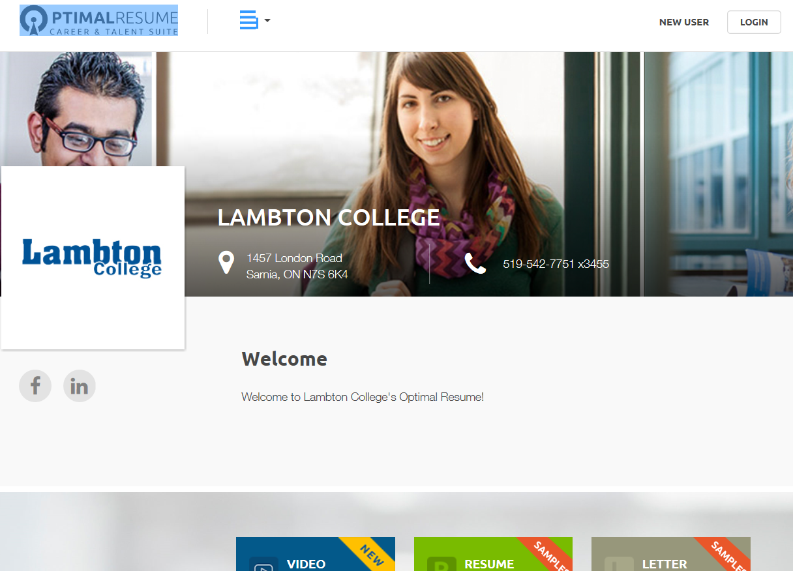
https://lambton.optimalresume.com/
*Create an Account Login using your Lambton College email

Slide 23
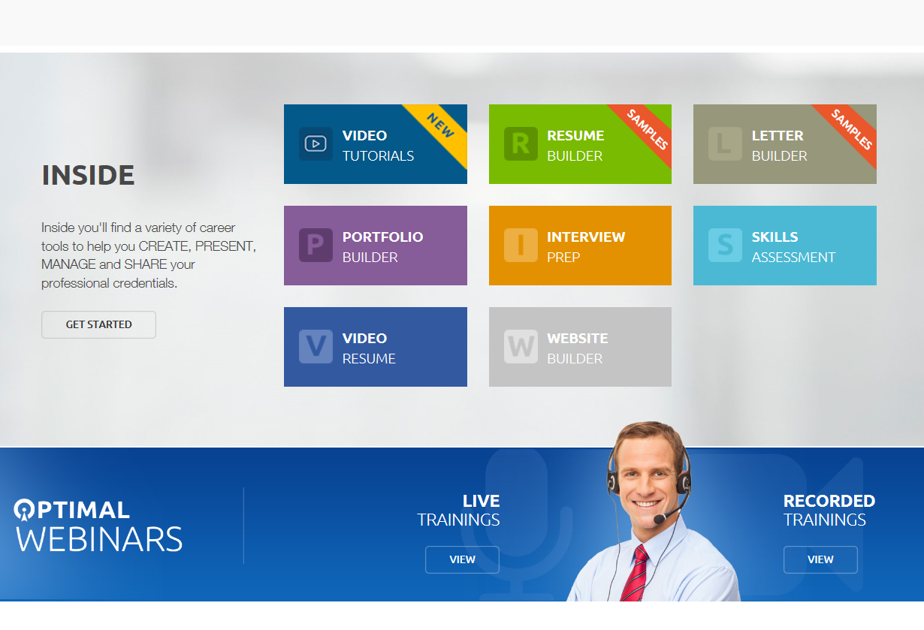

Slide 24
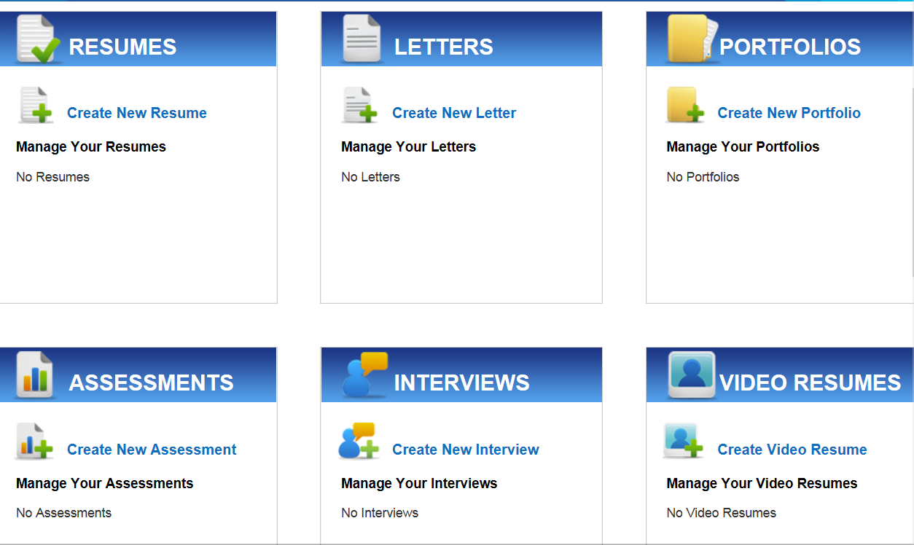

Slide 25
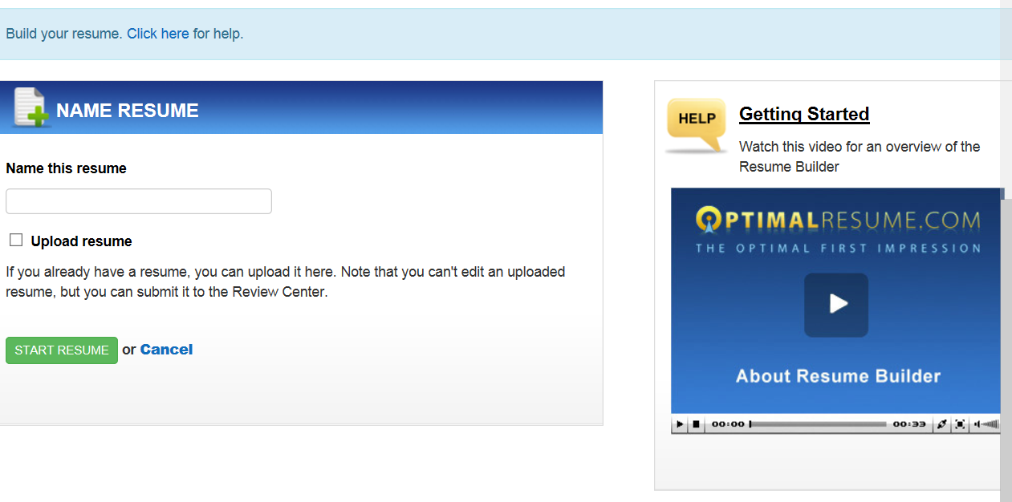

Slide 26
Week #5 – Online Work
Read:
http://www.sheknows.com/living/articles/6465/a-good-rsum-versus-a-great-rsum
Optimal Resume
Login and create an account
Watch the following video tutorials
The Optimal Resume Strategy
Top 10 Tips for Resume Formatting
Create a resume using Optimal Resume – (you can upload an existing resume into the system and edit it there)
Save your resume to Word
upload it into the dropbox
Resumes Samples
Find an example of a poor resumes – upload into the dropbox
Find an example of a great resumes – upload into the dropbox

